Slide 1
Engaging non-science majors: Tips & strategies
Drs. Kristin Krueger & Paula Tomczak
Department of Anthropology

Slide 2
Why us?
AY, J-Term, Summer: ENVS 101, ANTH 101 & 105
Hundreds of students from across campus!

Slide 3
Why now?
Importance of scientific literacy in an increasingly scientific-dependent world
Climate change, scientific racism, COVID-19 vaccines = social justice!

Slide 4
EX: IPCC report: 8/9/21
Intergovernmental Panel on Climate Change
“It is unequivocal that human influence has warmed the atmosphere, ocean and land.” p. 5

Slide 5
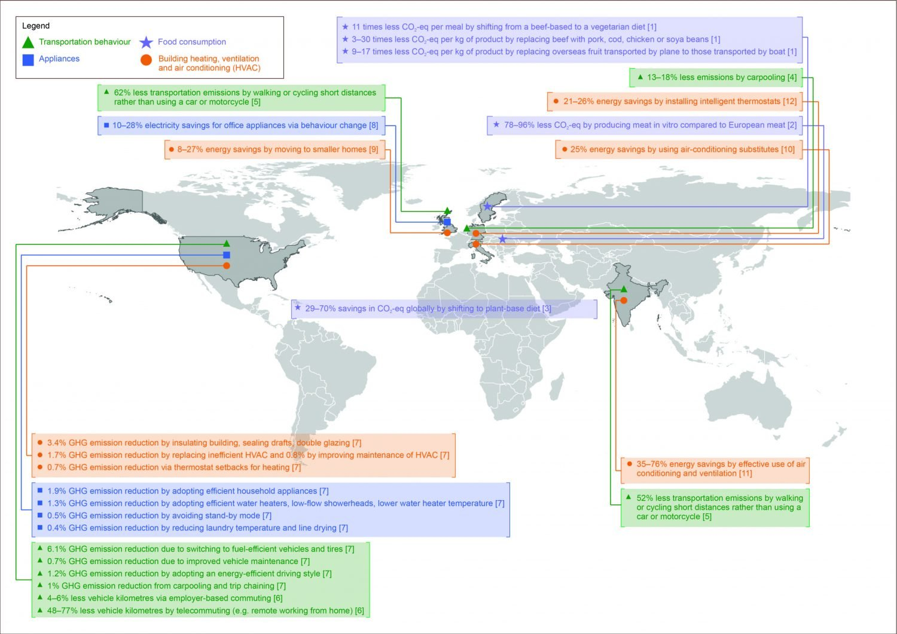
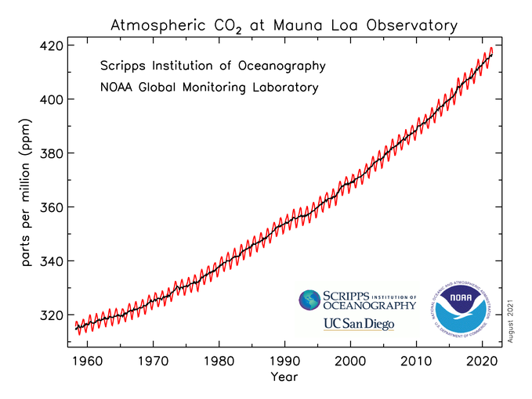
EX: IPCC report: 8/9/21
Figure 4.3
Notes:
We must inform our students of the evidence and prepare them for the effects and mitigation strategies

Slide 6
EX: COVID-19 deaths in chicago
“African Americans constituted 70% of early COVID-19 deaths despite composing only 30% of the population, and deaths continue to cluster in neighborhoods where more than 90% of the residents are African American.”
Peek et al., 2021

Slide 7
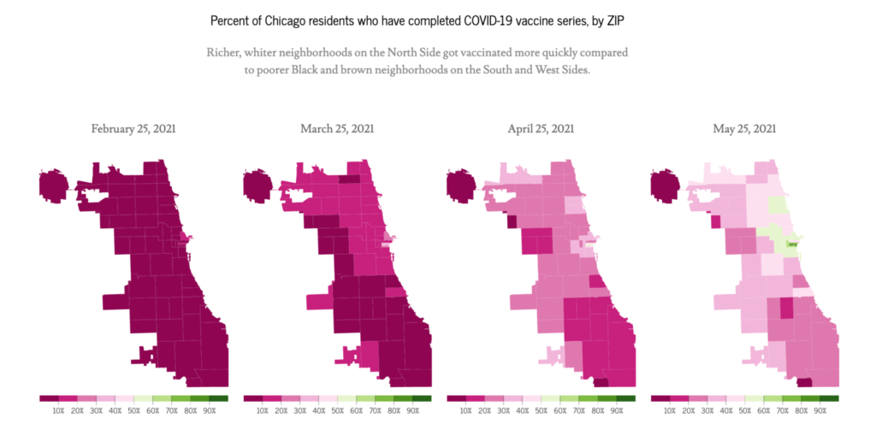
EX: covid vaccinations in chicago
Source: South Side Weekly, 6/24/21

Slide 8
Our responsibility
Scientific literacy…
…allows for critical thinking.
…helps students see the interdependency of life on Earth.

Slide 9
What’s the problem?
LUC Core requirements: Scientific Literacy (Tiers I and II)
Students put this off!
Why? Science anxiety

Slide 10
Why are students anxious?
“I’m not good at science!”
“Science is confusing and hard for me.”
Past negative experiences with science!

Slide 11
How can we help?
Acknowledge the worry, fear, trepidation!
Encourage students to let go, try again!
Build rapport, confidence!
Slow down, repeat, watch faces!

Slide 12
How can I assess?
Ask students 1-on-1 before class
Encourage questions after class/email/zoom
Exit tickets: 1 thing you learned, 1 question you have!

Slide 13
Make it relevant
Science has to connect to a student’s life!

Slide 14
EX: Connect to life
Weekly Reflections
What relationship or connection can you make between this week’s material and your life?

Slide 15
Make it relevant
Provide PRACTICAL APPLICATIONS to scientific knowledge

Slide 16
EX: practical applications
DNA & genetics: genetic testing during pregnancy
Primate behavior: playground equipment
Human evolution: climate change & adaptation

Slide 17
EX: practical applications
Ecological footprint
Toxic Release Inventory (TRI)
Food insecurity

Slide 18
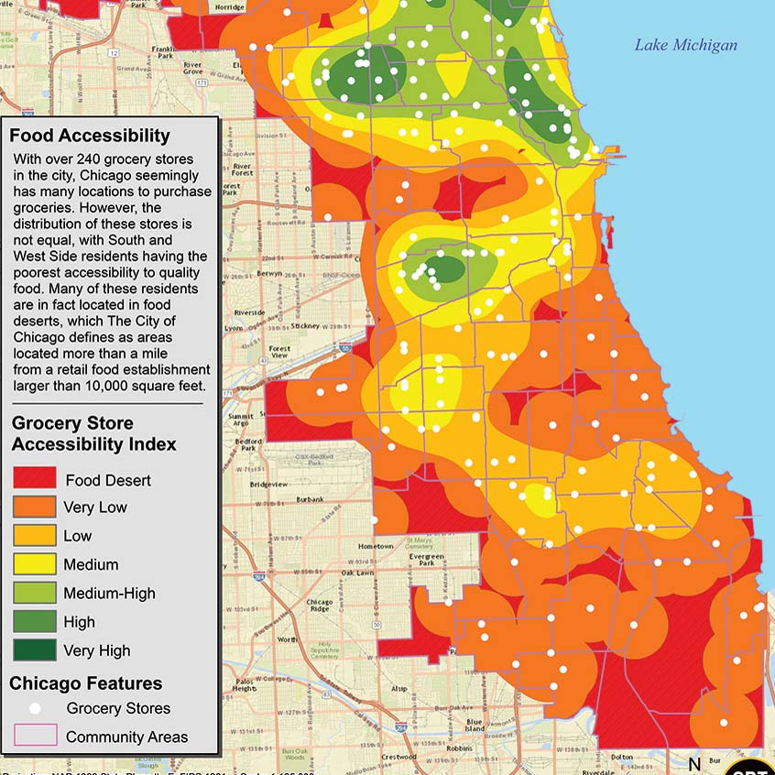
Food Deserts in Chicago
Source: The Urban Farm

Slide 19
Make it fun
Offer alternative ways for students to demonstrate their understanding of material

Slide 20
Ex: alternatives
Tell me about a day in the life of your favorite hominin (human ancestor).
Comic strip
Poem
Journal entry
Tinder profile!

Slide 21
Student engagement in large classes
When classes exceed 150 students
Exit tickets
Reflections
Focus on same strategies

Slide 22
What are other engagement strategies?

